Slide 1




Consumer Goods Ad_Hoc Insights
Presented by Venkata Sai

Slide 2

Agenda
A
About Atliq Hardwares
B
Objective of the project
Data structure and schema
C
Insights
D

Slide 3


ABOUT ATLIQ HARDWARES

Slide 4
Atliq Hardwares is one of the leading computer hardware producers in India and well expanded in other countries too.
P&A
Peripherals and Aceessories
A
A
PC
Personal Computer
N&S
Network and Storage
C
B
C

Slide 5
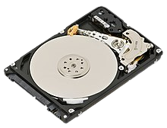
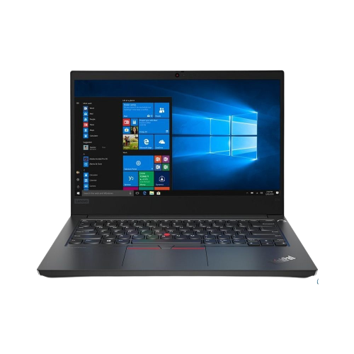

ATLIQ HARDWARES
P&A
N&S
PC
Monitor
Printer
Mice
Keyboard
Headphones
Webcams
Power Supply
etc.
Hard Drives
Modems
Routers
Switches
Cables & Connectors
RAM
Pendrives etc.
Desktop Computers
Laptops
Notebooks

Slide 6
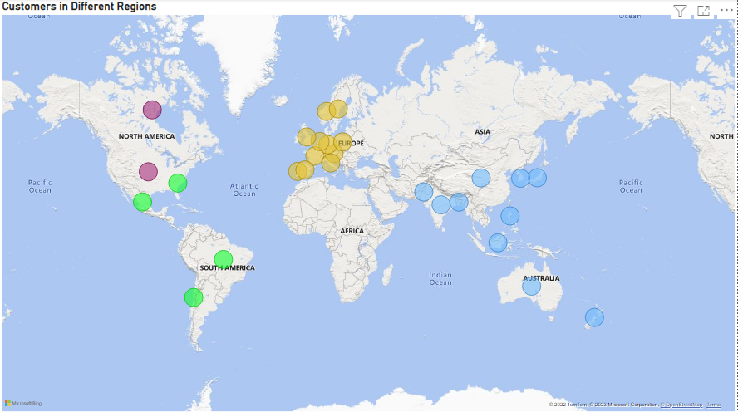
ATLIQ HARDWARES AROUND THE WORLD
APAC
EU
NA
LATAM

Slide 7


OBJECTIVES OF THE PROJECT
The management of Atliq Hardwares noticed that they do not get enough insights to make quick, smart and data-informed decisions.
So they approached us to analyse and explore data from the consumer goods sales to make informed decisions and provide insights to ten ad-hoc requests.

Slide 8
DATASETS OF THE PROJECT
contains monthly sales data for each product.
contains gross price information for each product
contains customer-related data
fact_sales_
monthly
dim_customer
fact_gross_price
dim_product
fact_pre_invoice
deduction
fact_manufacturing_cost
contains product-related data.
contains pre-invoice deductions information for each product
contains the cost incurred in the production of each product

Slide 9
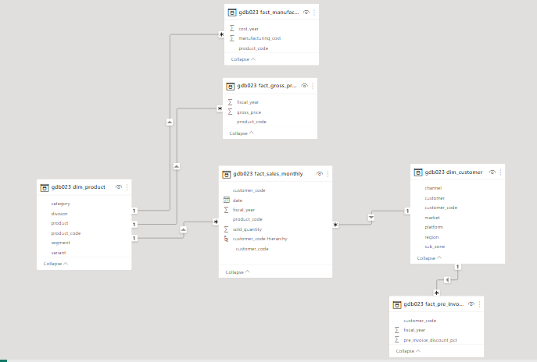
DATA STRUCTURE AND SCHEMA

Slide 10

INSIGHTS

Slide 11
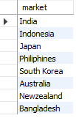
Atliq Exclusive customers in “Asia Pacific Region (APAC)”
Request 1:
Provide the list of markets in which customer "Atliq Exclusive” operates its business in the APAC region.
Output:

Slide 12
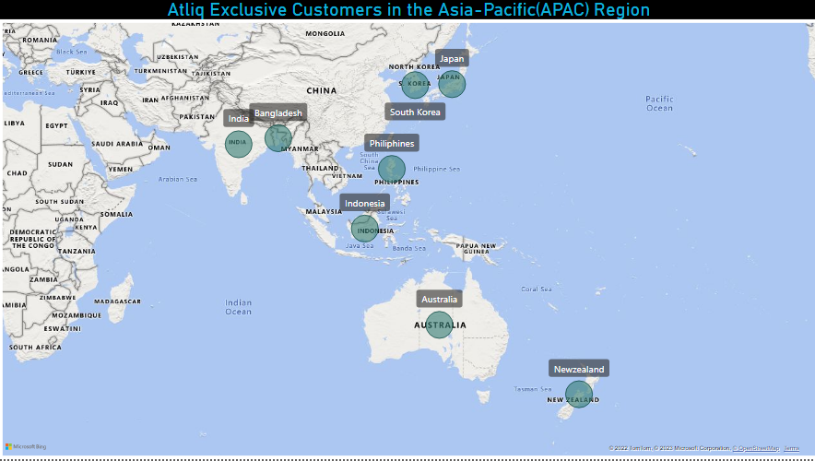
01
Insights:
Atliq Hardwares expanded their ‘Atliq Exclusive’ customers in 8 major markets in the APAC Region.
Atliq Hardwares have their business in all sub-zones of APAC region like India, ROA and ANZ.

Slide 13

Percentage of Unique Products Increase in 2021 vs 2020
Request 2::
What is the percentage of unique product increase in 2021 vs 2020?
The final output contains these fields:
unique_products_2020
unique_products_2021
percentage_chg
Output:

Slide 14
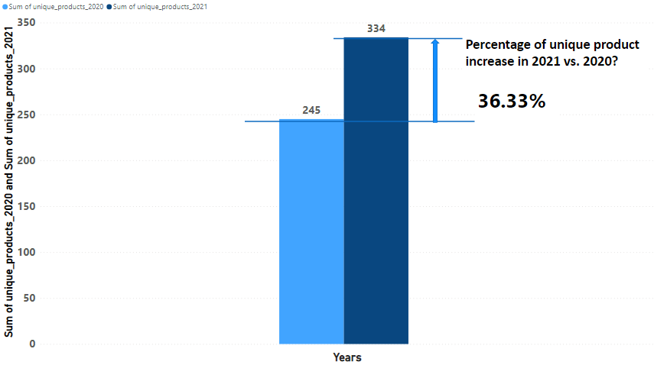
02
Insights:
Number of unique products in the year 2020 is 245 and 334 in the year of 2021. Hence the percentage of the unique products increase is grown by 36.32%.
Increase in the number of products indicates the company growth offering new products resulted by the customer satisfaction.

Slide 15
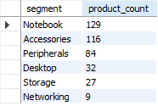
Product counts for each segment
Request 3::
Provide a report with all the unique product counts for each segment and sort them in descending order of product counts. The final output contains two fields:
segment
product_count
Output:

Slide 16
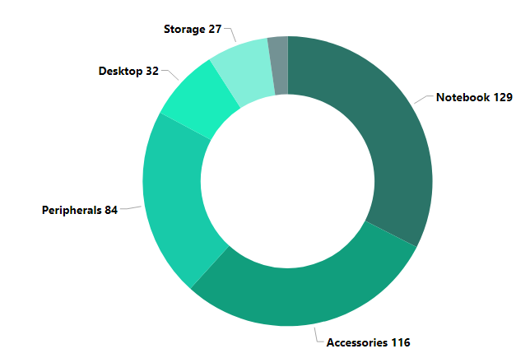
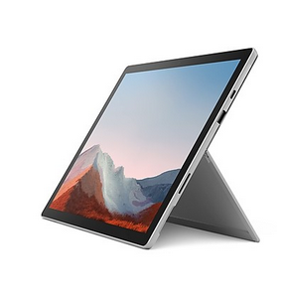
03
Insights:
Results indicate Atliq Hardwares are competitive by introducing more products in Notebook segment offering wide range of unique products (129).
Atliq hardwares are focusing in manufacturing more products like Notebooks, Accessories compared to products like Storage & Networking parts.
Unique Products Count by Segment

Slide 17
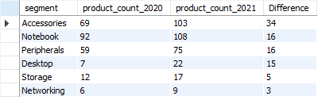
Unique product counts for each Segment in 2020 vs 2021
Request 4::
Which segment had the most increase in unique products in 2021 vs 2020?
The final output contains these fields
segment
product_count_2020
product_count_2021
difference
Output:

Slide 18
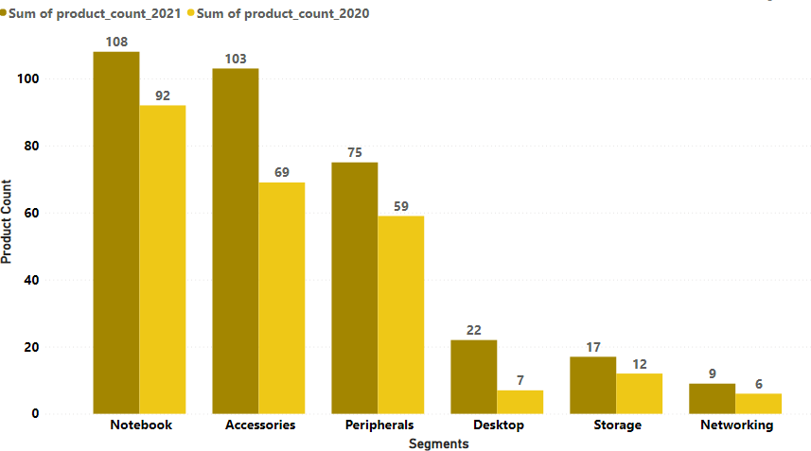
04
Insights:
Atliq Hardwares have introduced 34 unique products in the Accessories segment in 2021 compared to 2020. It shows Atliq Hardwares is offering more unique products in the Accessories segement.
Atliq hardwares is focusing on manufacturing more products in all segments to increase their number of unique products in 2021 compared to 2020. Strategic decisions are positively impacting in offering more Unique Products.

Slide 19

Products with Highest and Lowest Manufacturing Cost
Request 5::
Get the products that have the highest and lowest manufacturing costs. The final output should contain these fields
product_code
product
manufacturing_cost
Output:

Slide 20
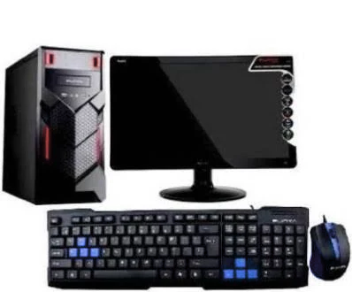
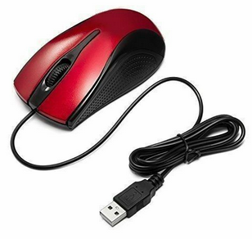
05
05
Products with Highest and Lowest Manufacturing Cost
$240.53
$0.89
Highest Manufacturing Cost Product is for ‘’Atliq Home Allin 1 Gen 2” at 240.53
Lowest Manufacturing Cost Product is for ‘’Atliq Master Wired Mouse” at 0.89

Slide 21
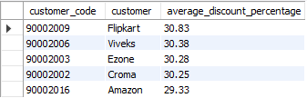
Top 5 Average High Discount Percentage Customers
Request 6::
Generate a report which contains the top 5 customers who received an average high pre_invoice_discount_pct for the fiscal year 2021 and in the Indian market. The final output contains these fields
customer_code
customer
average_discount_percentage
Output:

Slide 22





05
06
Top 5 Average High Discount Percentage Customers
30.8%
30.4%
Insights:
1.Top 5 Average High Discount customers get the discount in a similar range between 30.8% and 29.3%
2.Atliq Hardwares maintains good customer relationships with these top 5 customers.
30.3%
30.3%
29.3%

Slide 23
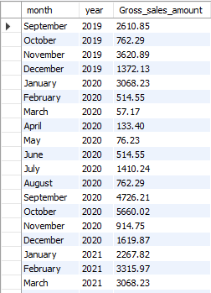

Gross sales Report for “Atliq Exclusives”
Request 7::
Get the complete report of the Gross sales amount for the customer “Atliq Exclusive” for each month.

Slide 24
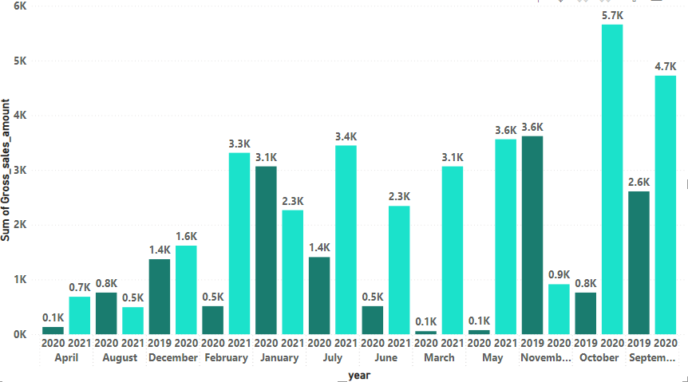
07
Insights:
1.Atliq Hardwares has highest gross sales in October 2020
2.In every month compared to 2020, sales increased in 2021, except for the month of November.

Slide 25

Total Sold Quantity in 2020 By Quarters
Request 8::
In which quarter of 2020, got the maximum total_sold_quantity?The final output contains these fields sorted by the total_sold_quantity
Quarter
total_sold_quantity
Output:

Slide 26
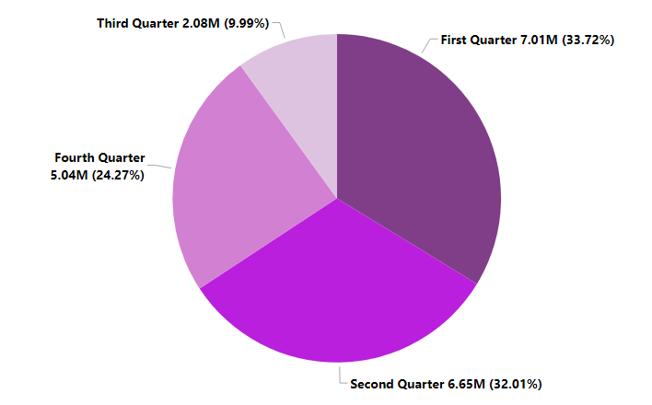
08
Insights:
Atliq Hardwares has the highest total sales volume in the first quarter, i.e. from September to November 2019, which is 7.01 million, and second highest in the second quarter, i.e. from December 2019 to January 2020, which is 6.65 million.
But in the third quarter, the sales have decreased drastically and in the fourth quarter, it has increased again
Total sold Quantity by Quarter

Slide 27

Gross Sales Distribution by Channels
Request 9::
Which channel helped to bring more gross sales in the fiscal year 2021 and the percentage of contribution? The final output contains these fields c channel
gross_sales_mln
percentage
Output:

Slide 28
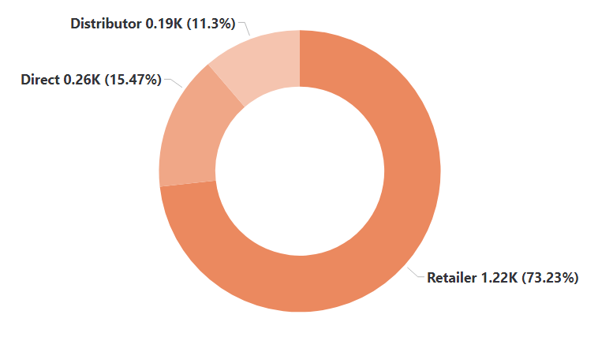
09
Gross Sales by Channel
Insights:
Atliq Hardwares has the highest revenue from retailers which is 1219 million they are in business-to-business, direct and distributors have contributed very little which totals 455 million Gross sales in the year 2021.

Slide 29
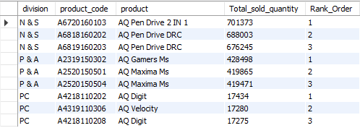
Top 3 Products in each division with High total_sold_quantity
Request 10::
Get the Top 3 products in each division that have a high total_sold_quantity in the fiscal_year 2021? The final output contains these fields
division ,product_code,product ,total_sold_quantity ,rank_order.
Output:

Slide 30
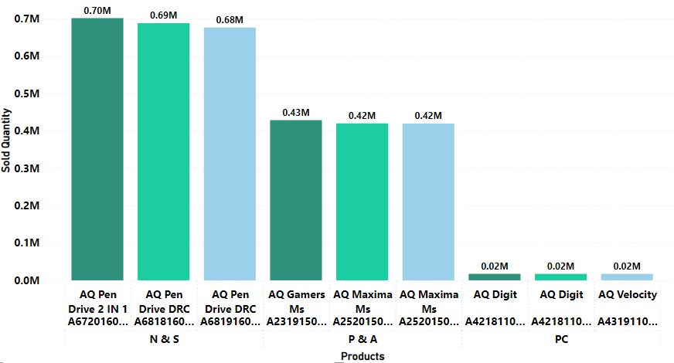
10
Insights:
In the N&S division, Pendrive is Atliq Hardwares's best-selling hardware, in the P&A division it is the wired mouse, and in the PC division it is the desktop PC, which sells the most.

Slide 31


